Slide 1

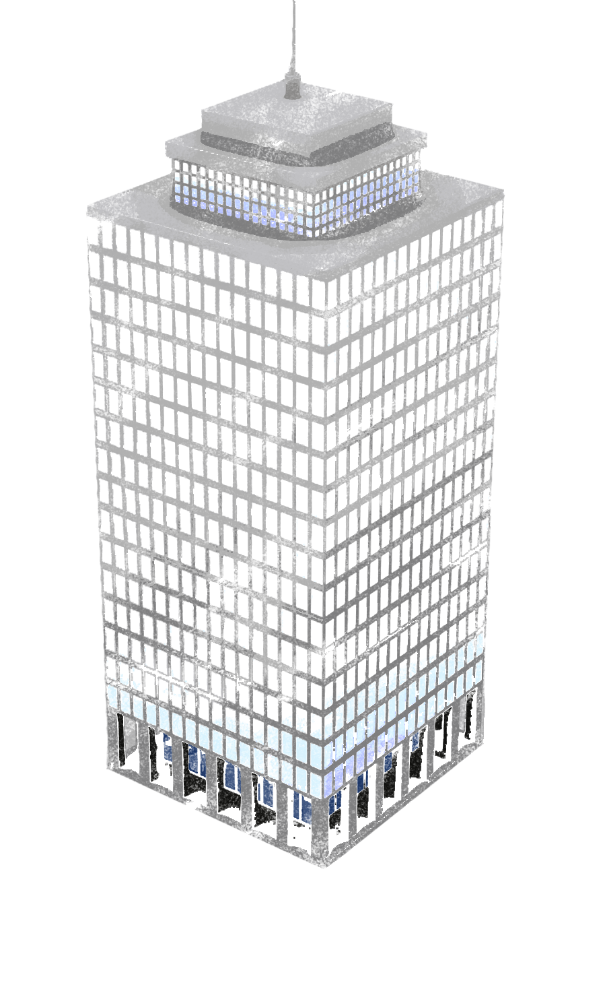

Introduction to DevOps on AWS
October 2014

Slide 2
Agenda
Intro to DevOps (evolution, principles, practices)
Infrastructure as Code
Continuous Integration / Continuous Deployment CI/CD
IT/Infrastructure Automation
DevOps on AWS
CloudFormation
Elastic Beanstalk
OpsWorks
BlueGreen deployment
Deployment Models (AMIs)

Slide 3

DevOps
What is it ?
A philosophy? Cultural change? Paradigm shift ?
Alignment of development and IT operations with better communication and collaboration ?
Improvement in software deployment ?
Breaking down the barriers between development and IT operations ?
Akin to Agile software development applied to infrastructure and IT operations
It’s all of the above !!!
Principles
Code
Wal
l
Developer
IT Operations
Notes:
WIKIPEDIA – DevOps is a software development method that stresses communication, collaboration and integration between software developers and information technology (IT) operations professionals.
Development and IT operations can be siloes having different: goals, mgt, processes and procedures
Developers are paid to change things i.e. write code,
Ops folks are paid to NOT change things and keep things stable
Failed deployment have caused serious corporate issues and have potentially put companies out of business (or put them on the front page of the newspaper)

Slide 4

Evolution of DevOps from Agile
Business Case
Use Case
Requirements
Plan
Go to market
Features
Business
Agile
Development
Iterative development
Scrum, sprints, stories
Velocity
Business
Agility
Design
Refactor
Unit Test
Bug Fix
Deploy
Code
Developers
(application)
Continuous Integration
Continuous Deployment
IT Automation
Application Management
IT
Agility
DevOps
Provision
Orchestrate
Deploy
Configure
Report
Monitor
IT Operations
(infrastructure)
Notes:
Agile originates in the development space and improved the collaboration and communication between business and developers
Business Agility = ability to react to the market and client needs quickly
Agile approaches are moving downstream towards infrastructure and operations

Slide 5
DevOps Principles
Collaboration
Breakdown the barriers
Work as one team end to end
Treat Infrastructure as code
Support business and IT agility
Automate everything
Test everything
Measure & monitor everything
Notes:
No more MANUAL HACKING.
Infrastructure should be treated like the application source code.
It should be maintained in version control
Application management include Application Source Code and Infrastructure defined in Code

Slide 6
DevOps Practices
Infrastructure as code
IT Automation
Continuous Integration
Application
Compile, test, optimize (code coverage)
Infrastructure
Logical, valid, secure
Continuous Deployment
Application
Rollout & Rollback
Version control integration
Application and Infrastructure version management
Monitoring and logging

Slide 7
Infrastructure as code – why ?
Scalability (anything manual is not scalable)
Reliability
Reproduction/Duplication
Environment consistency
Auditability/Record Keeping
Security
Governance

Slide 8


Here’s some infrastructure as Code
"WebServer": {
"Type": "AWS::EC2::Instance",
"Metadata" : {
"AWS::CloudFormation::Init" : {
"config" : {
"packages" : {
"yum" : {
"httpd" : [],
"php" : [],
"php-mysql" : [],
"php-gd" : [],
"php-xml" : [],
"php-mbstring" : [],
"mysql" : []
}
},
"sources" : {
"/var/www/html" : "http://ftp.drupal.org/files/projects/drupal-7.8.tar.gz",
"/home/ec2-user" : "http://ftp.drupal.org/files/projects/drush-7.x-4.5.tar.gz"
},
AWS CloudFormation
template
Notes:
Cloud Formation is a core component of deployment and infrastructure and application management on AWS
Uses JSON (Javascript object notation) format, basically key value pairs
Contains all the meta data about the resources
Supports wide range of AWS resources: DynamoDB, EC2, Elastic Beanstalk, IAM, RDS, Redshift, S3, SNS, SQS, VPC ……..

Slide 9
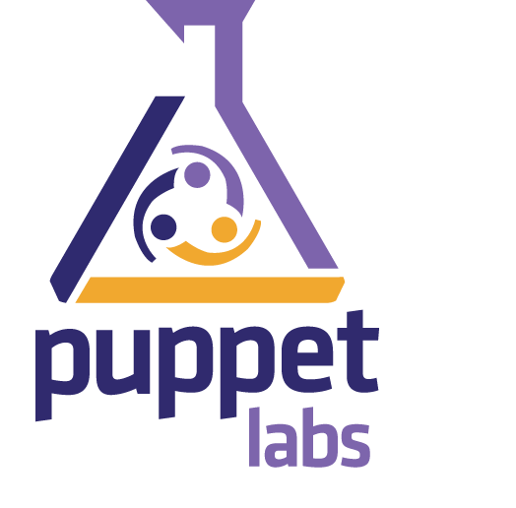

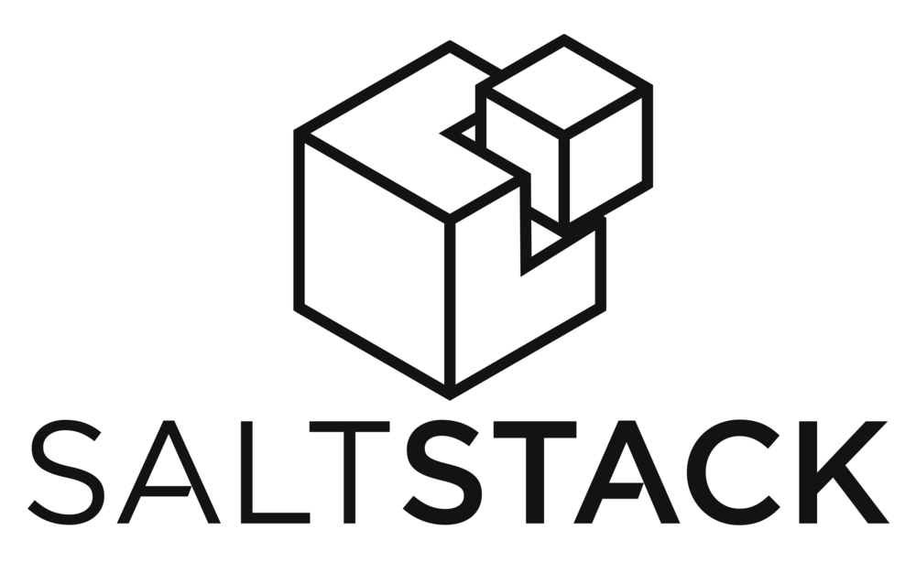



Automation and configuration management
Declarative Approach to:
Provisioning
Configuration
Orchestration
Reporting
OpsWorks
CloudFormation
Elastic Beanstalk
Notes:
Use programming languages like Ruby and Python to declare configurations.
Can use CloudFormation with any of the above. E.g. use CloudFormation to setup Puppet Master and Puppet Client

Slide 10
Continuous Integration & Continuous Deployment
Application AND Infrastructure
Nothing Manual – Automate as much as possible
Define infrastructure declaratively
Architect infrastructure carefully including security
Treat definitions and configurations like application code
Store in version control
Infrastructure is part of the application
Automate testing (end to end)
Plan for rollback
Monitor, log and audit

Slide 11







Continuous Integration / Continuous Delivery
Help prove code quality and function repeatedly with predefined results
Lots of options; self hosted, open source, closed source, and SaaS
Monitoring, testing, validation
Plugins
Notes:
Building/testing software projects continuously, improve software quality
Monitoring executions of externally-run jobs
Scheduling, cron jobs
Dashboards & Reports
Numerous plugins – version control, Mavern, ant,
Jenkins – Open Source, Industry Standard

Slide 12

Continuous Integration / Deployment & Automation
Application
Deploy application
only
Write
App Code
Build/
Compile
Code
Unit Test
App Code
Package
Application
Deploy
App
tar, war, zip
yum, rpm
Dev Env
Dev
Test Env
Version Control
Artifact Repository
DR Env
CloudFormation
Write
Infra Code
Build
AMIs
Validate
Templates
Automate
Deployment
Deploy
Infras
Prod Env
IT Ops
Infrastructure
Deploy infrastructure
only
AMI
Notes:
Pulling it all together
Two work streams APPLICATION and INFRASTRUCTURE
Version control for code AND infrastructure configs
CICD for application code AND infrastructure configs
Can deploy independently or together using AMIs
All process are iterative

Slide 13
DevOps on AWS: Deployment & Management
Cloud Formation
Elastic Beanstalk
OpsWorks
BlueGreen deployment

Slide 14


















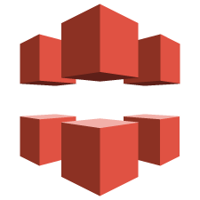










AWS Global Infrastructure
Monitoring
Deployment & Management
Identity & Access
Deployment &
Management
CloudWatch
BeanStalk
OpsWork
Cloud Formation
CloudTrail
IAM
Federation
AWS Global Infrastructure
Application Services
Application
Services
SES
SNS
SQS
Elastic Transcoder
CloudSearch
SWF
AppStream
Databases
Analytics
Content Delivery
RDS
Dynamo
ElastiCache
RedShift
EMR
DataPipeline
Kinesis
CloudFront
Foundation
Services
Compute
Storage
Networking
EC2
WorkSpaces
S3
EBS
Glacier
Storage
Gateway
VPC
Direct Connect
ELB
Route53

Slide 15
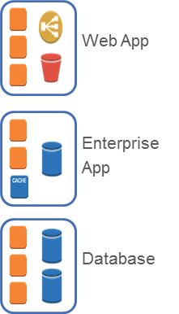
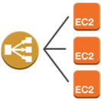



Deployment and Management
AWS Elastic Beanstalk
AWS OpsWorks
AWS CloudFormation
DIY /
On Demand
Automated resource management – web apps made easy
DevOps framework for application lifecycle management and automation
Templates to deploy & update infrastructure as code
DIY, on demand resources: EC2, S3, custom AMI’s, etc.
Convenience
Control
Control

Slide 16
Example Supported DevOps Practices on AWS
IT automation
Built in and can be combined with 3rd party tools
Version control Integration (Integration with Git, SVN)
Application version management
Infrastructure as code
Infrastructure version management
Deployment
Rollback
Monitoring & logging

Slide 17
Amazon Elastic Beanstalk
Automated infrastructure management & code deployment for your application
Includes:
Load balancing
Health monitoring
Auto Scaling
Application platform management
Code deployment
AWS Elastic Beanstalk
Notes:
Elastic Beanstalk
– application container
- Setup and managing an application's infrastructure
Provides support for common architectures
Can be customized

Slide 18



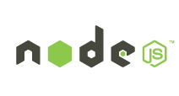



Amazon Elastic Beanstalk
Supports:
Java | PHP | Python | Ruby | .NET | Node.js | docker
Notes:
AWS Elastic Beanstalk supports several platforms, including Java, Windows (and .NET), Node.js, PHP, and Ruby.

Slide 19






Example Elastic Beanstalk Architecture
Route 53 Hosted Zone
Elastic Load
Balancing
Web Server
Web Server
Web Server
Web Server
Auto scaling Group
Auto scaling Group
RDS DB Instance
RDS DB Instance Standby
S3 Bucket
Availability Zone
Availability Zone
Notes:
Example Elastic Beanstalk Architecture

Slide 20
Amazon Elastic Beanstalk
Scalability
Software updates and patches
Security
Content delivery
Elastic Beanstalk
Storage
Fault tolerance
Notes:
Scalability. Do you need to scale up, or scale out? Also, is your application as stateless as possible?
Security. What are the security requirements of your organization?
Persistent storage. Elastic Beanstalk does not use persistent storage. Apps need to leverage services like Amazon Elastic Block Store or Amazon S3.
Fault tolerance. When you set up an Elastic Beanstalk environment, you can decide how many availability zones to use. We recommend that you use at least two (more is better) availability zones to help keep your system as available and fault tolerant as possible.
Content delivery. How will users access your application? Leveraging tools like Route 53 and CloudFront can be advantageous.
Software updates and patching. Running Elastic Beanstalk environments do not get automatically updated. Instead, you have to launch a new environment – or manage updates and patching separately.

Slide 21
AWS OpsWorks
Application infrastructure management
Linux and Chef
Primary components:
Stacks
Layers
Instances
Apps
AWS OpsWorks
Notes:
OpsWorks – application management
OpsWorks divides app deployment into four categories: stacks, layers, instances, and apps.

Slide 22
Application Management - OpsWorks
instances
applications
Scalability
Auto healing
Auto scaling
Load balancing
Scaling – time
Scaling - load
Configure Application
Source of packages
Git, svn, S3
layers
Application Architecture
Load balancers
Web layer
Elastic IP’s
Security groups
Database layer
deployments
Deployment
Environments
Dev, Test, Prod
stack
monitoring
Infrastructure Provisioning
Region
Availability Zone
Operating system
Keys
Monitoring
Logs
Monitor
AWS OpsWorks
Notes:
STACK = container of resources, LAYER = set of resources performing a purpose, INSTANCE = an EC2 instance. APP – defines application, type and its repository info
Part of AWS Deployment and Management offerings – is FREE !!!
OpsWorks makes it easy to deploy AND operate operations. Define the application’s architecture and the specification of each component including package installation, software configuration and resources such as storage.
Use existing templates or build your own
Mention Chef recipes used in OpsWorks – for stack definition and deployment

Slide 23
Amazon CloudFormation
Infrastructure as Code
Integrates with version control
JSON format
Templates
Stacks
Supports all AWS resource types
AWS CloudFormation

Slide 24
AWS CloudFormation: Model Your App
Document, version control, and share your applications and infrastructure as a JSON document
Provision app and other AWS resources (VPC, DynamoDB, etc) from a template
Repeatable, reliable deployments for test/dev/prod in any AWS Region

Slide 25
Resource Property Types
Autoscaling
CloudFront
CloudWatch
DynamoDB
EC2
Elastic Beanstalk
Elastic Load Balancer
IAM
OpsWorks
RDS
S3
SNS/SQS

Slide 26
Example options for a VPC resource
VPN Access
DHCP Options
Customer Gateways
Virtual Private Gateways
Network ACLs
Security Groups
More …

Slide 27
AWS CloudFormation: Application stack example
RR 1
Web Servers
App
Master
RR 2
Amazon Route 53
Elastic Load Balancer
RR 3
Standby
Web Servers
App
ElastiCache Cluster
Web ASG
Elastic Beanstalk
RR 4
CloudFront Distribution
S3 Bucket
Notes:
Notes:
Example application stack running in AWS.

Slide 28
AWS CloudFormation: Application stack example (continue)
Use the version control system of your choice to store and track changes to this template
Build out multiple environments, such as for Development, Test, and Production using the template
Dev
Git
Subversion
Mercurial
Test
Prod
Template File Defining Stack
The entire application can be represented in an AWS CloudFormation template.
Notes:
Notes:
The entire application can be represented in an AWS CloudFormation template.
You can use the version control system of your choice to store and track changes to this template.
You can use the template to quickly build out multiple environments, such as for Development, Test, and Production.

Slide 29
AWS CloudFormation Example (1 of 3)
{
"Description" : "Create an EC2 instance running the Amazon Linux 32 bit AMI.”,
"Parameters" : {
"KeyPair" : {
"Description" : "The EC2 Key Pair to allow SSH access to the instance",
"Type" : "String"
}
},
"Resources" : {
"Ec2Instance" : {
"Type" : "AWS::EC2::Instance",
"Properties" : {
"KeyName" : { "Ref" : "KeyPair" },
"ImageId" : "ami-75g0061f”,
“InstanceType” : “m1.medium”
}
}
},
"Outputs" : {
"InstanceId" : {
"Description" : "The InstanceId of the newly created EC2 instance",
"Value" : { "Ref" : "Ec2Instance” }
}
}
}

Slide 30
AWS CloudFormation Example (2 of 3)
{
"Description" : "Create an EC2 instance running the Amazon Linux 32 bit AMI.”,
"Parameters" : {
"KeyPair" : {
"Description" : "The EC2 Key Pair to allow SSH access to the instance",
"Type" : "String"
}
},
"Resources" : {
"Ec2Instance" : {
"Type" : "AWS::EC2::Instance",
"Properties" : {
"KeyName" : { "Ref" : "KeyPair" },
"ImageId" : "ami-75g0061f”,
“InstanceType” : “m1.medium”
}
}
},
"Outputs" : {
"InstanceId" : {
"Description" : "The InstanceId of the newly created EC2 instance",
"Value" : { "Ref" : "Ec2Instance” }
}
}
}
Notice that you need to use an EC2 KeyPair for the CloudFormation template to work.

Slide 31
AWS CloudFormation Example (3 of 3)
{
"Description" : "Create an EC2 instance running the Amazon Linux 32 bit AMI.”,
"Parameters" : {
"KeyPair" : {
"Description" : "The EC2 Key Pair to allow SSH access to the instance",
"Type" : "String"
}
},
"Resources" : {
"Ec2Instance" : {
"Type" : "AWS::EC2::Instance",
"Properties" : {
"KeyName" : { "Ref" : "KeyPair" },
"ImageId" : "ami-75g0061f”,
“InstanceType” : “m1.medium”
}
}
},
"Outputs" : {
"InstanceId" : {
"Description" : "The InstanceId of the newly created EC2 instance",
"Value" : { "Ref" : "Ec2Instance” }
}
}
}
You can define exactly what type of EC2 instance you want to launch.

Slide 32
Example - Putting it all together !!

Slide 33
Sample Architecture

Slide 34
Sample Architecture with CloudFormation

Slide 35
Sample Architecture with CloudFormation

Slide 36
AWS Elastic Beanstalk & OpsWorks
Elastic Beanstalk:
Application container framework similar to a PaaS
Deploy your application into Elastic Beanstalk and it takes care of building a self healing, auto-scaling, multi-AZ infrastructure
Allows you to turn some of the knobs under the hood to tweak
Considered one of the easiest places to start with hosting an application on AWS
OpsWorks:
Build multi-layer application stacks
Ties in with Chef for a large degree of flexibility and customization
Makes deploying applications easier
More flexible than Elastic Beanstalk, but requires a bit more knowledge

Slide 37
Sample Architecture
OR

Slide 38
Deployment Models

Slide 39
AMI Deployment Method
Code gets bundled into an AMI, we then deploy that AMI
Pluses
Very atomic
New shouldn’t effect older versions
Can deploy alongside current
Easy tools to automate
Cons
Bit more work involved
Have to think about where your data is persisting
Schema updates potentially harder to package in
Leverage configuration management tools in automation process

Slide 40
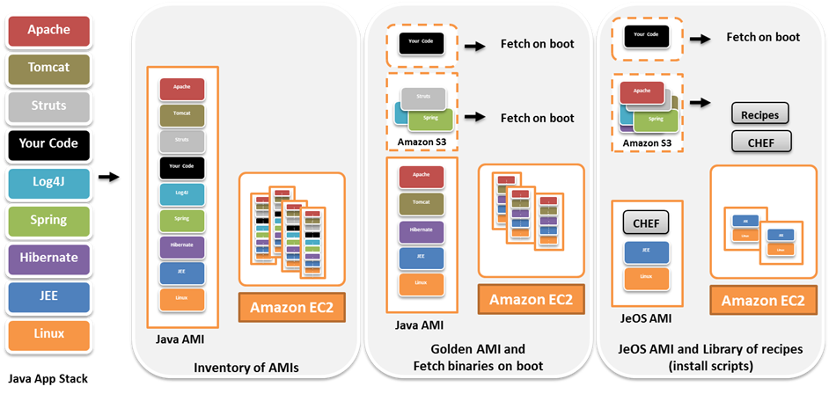
AMI Deployment Method - Building

Slide 41
AMI Deployment Method - Building
Fully Functional AMI
OS-Only AMI
Partially Configured AMI

Slide 42
AMI Deployment Method - Building
Fully Functional AMI
OS-Only AMI
Least flexible
to maintain
Partially Configured AMI

Slide 43
AMI Deployment Method - Building
Fully Functional AMI
OS-Only AMI
Least flexible
to maintain
Most amount of post-boot work
Partially Configured AMI

Slide 44
AMI Deployment Method - Building
Fully Functional AMI
OS-Only AMI
Least flexible
to maintain
Try and find a happy medium here
Most amount of post-boot work
Partially Configured AMI

Slide 45
AMI Deployment Method - Deploying
Blue/Green Deploys
We stand up a duplicate part of our infrastructure and slowly cut traffic over to it
Shift via DNS
Makes it easy to do testing of new features
Makes it easy to roll back
As we shift more traffic over, let auto-scaling grow/shrink our instances of the new or old application
Shut down the old when no traffic there
Amazon Route 53
100%
ELB
EC2 Instances
DynamoDB
MySQL RDS
Instance
ElastiCache Cache Node

Slide 46
AMI Deployment Method - Deploying
Blue/Green Deploys
We stand up a duplicate part of our infrastructure and slowly cut traffic over to it
Shift via DNS
Makes it easy to do testing of new features
Makes it easy to roll back
As we shift more traffic over, let auto-scaling grow/shrink our instances of the new or old application
Shut down the old when no traffic there
Amazon Route 53
90%
10%
ELB
ELB
EC2 Instances
EC2 Instances
DynamoDB
MySQL RDS
Instance
ElastiCache Cache Node

Slide 47
AMI Deployment Method - Deploying
Blue/Green Deploys
We stand up a duplicate part of our infrastructure and slowly cut traffic over to it
Shift via DNS
Makes it easy to do testing of new features
Makes it easy to roll back
As we shift more traffic over, let auto-scaling grow/shrink our instances of the new or old application
Shut down the old when no traffic there
Amazon Route 53
50%
50%
ELB
ELB
EC2 Instances
EC2 Instances
DynamoDB
MySQL RDS
Instance
ElastiCache Cache Node

Slide 48
AMI Deployment Method - Deploying
Blue/Green Deploys
We stand up a duplicate part of our infrastructure and slowly cut traffic over to it
Shift via DNS
Makes it easy to do testing of new features
Makes it easy to roll back
As we shift more traffic over, let auto-scaling grow/shrink our instances of the new or old application
Shut down the old when no traffic there
Amazon Route 53
0%
100%
ELB
ELB
EC2 Instances
EC2 Instances
DynamoDB
MySQL RDS
Instance
ElastiCache Cache Node

Slide 49
AMI Deployment Method - Deploying
Blue/Green Deploys
We stand up a duplicate part of our infrastructure and slowly cut traffic over to it
Shift via DNS
Makes it easy to do testing of new features
Makes it easy to roll back
As we shift more traffic over, let auto-scaling grow/shrink our instances of the new or old application
Shut down the old when no traffic there
Amazon Route 53
0%
100%
ELB
ELB
EC2 Instances
EC2 Instances
DynamoDB
MySQL RDS
Instance
ElastiCache Cache Node

Slide 50
AMI Deployment Method - Deploying
Blue/Green Deploys
We stand up a duplicate part of our infrastructure and slowly cut traffic over to it
Shift via DNS
Makes it easy to do testing of new features
Makes it easy to roll back
As we shift more traffic over, let auto-scaling grow/shrink our instances of the new or old application
Shut down the old when no traffic there
Amazon Route 53
100%
ELB
EC2 Instances
DynamoDB
MySQL RDS
Instance
ElastiCache Cache Node

Slide 51
AMI Deployment Method - Deploying
Blue/Green Deploys
We stand up a duplicate part of our infrastructure and slowly cut traffic over to it
Shift via DNS
Makes it easy to do testing of new features
Makes it easy to roll back
As we shift more traffic over, let auto-scaling grow/shrink our instances of the new or old application
Shut down the old when no traffic there
Amazon Route 53
100%
ELB
EC2 Instances
DynamoDB
MySQL RDS
Instance
ElastiCache Cache Node

Slide 52
Further Reading
AWS Documentation - http://aws.amazon.com/documentation
AWS Technical Whitepapers – http://aws.amazon.com/whitepapers
AWS Architecture Center – http://aws.amazon.com/architecture

